Slide 1
Fruit Rotten Classifer
Deep learning project

Slide 2
Dataset
Class | Number of instances
Rotten apples | 2342
Fresh banana | 1581
Fresh oranges | 1466
Rotten banana | 2224
Rotten oranges | 1595
Fresh apples | 1693

Slide 3
Dataset
train samples of fresh apple: 1693
train samples of rotten apple: 2342
train samples of apple: 4035
train samples of fresh banana: 1581
train samples of rotten banana: 2224
train samples of banana: 3805
train samples of fresh orange: 1466
train samples of rotten orange: 1595
train samples of oranges: 3061

Slide 4
Dataset
train samples of orange: 3061
total train samples: 10901
test samples of fresh apple: 395
test samples of rotten apple: 601
test samples of apple: 996
test samples of fresh banana: 381
test samples of rotten banana: 530
test samples of banana: 911
test samples of fresh orange: 388
test samples of rotten orange: 403
test samples of orange: 791
total test samples: 2698

Slide 5
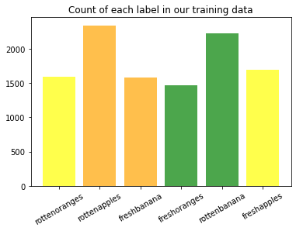
Dataset

Slide 6
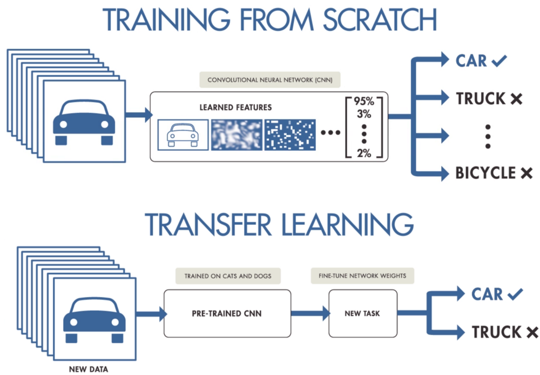
What is transfer learning?

Slide 7
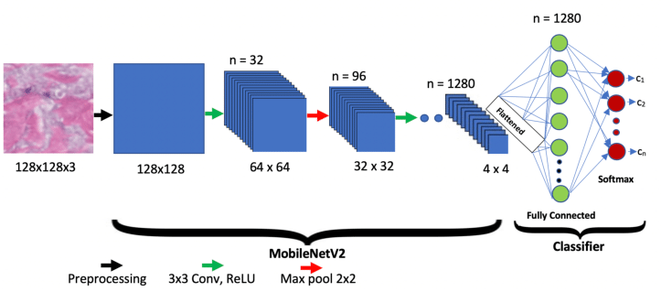
MobileNetV2

Slide 8
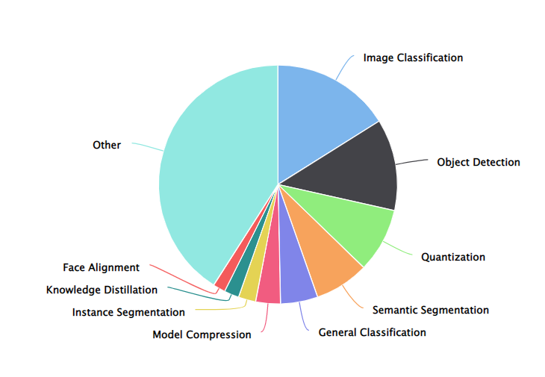
Why MobileNetV2

Slide 9
model = Sequential()
model.add(mobilenet_model)
model.add(Dense(units=320, activation='relu', kernel_regularizer=l2(0.001)))
model.add(GlobalAveragePooling2D())
model.add(Dense(units=6, activation='softmax'))
model.compile(loss='categorical_crossentropy',
optimizer=optimizers.Adam(1e-5),
metrics=['accuracy'])
model.summary()

Slide 10
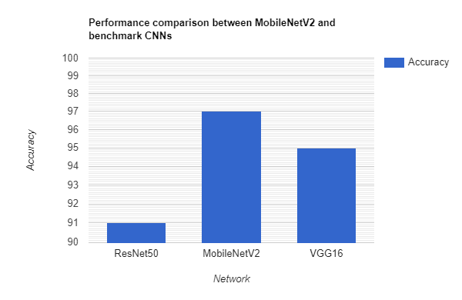
Performance

Slide 11
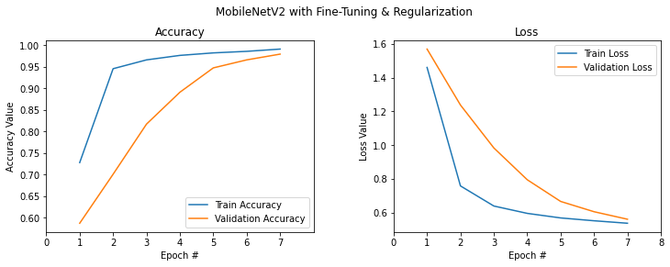
Accuracy and Error

